Slide 1

Cyclistic Riders’ Usage Behavior
Presented by: Khaled Faisal
Last Update: July 14th, 2022

Slide 2
Table of Contents
Cyclistic Riders’ Usage Behavior
Purpose Statement (What are we talking about?)
Riders’ Usage Behavior Analysis
Conclusion

Slide 3
What are we talking about?

Slide 4
Objective
Identify How do annual members and casual riders use Cyclistic bikes differently.

Slide 5
Cyclistic Riders' Usage Behavior Analysis

Slide 6
Rides Summary for the Past 12 Months
Category | Number of Rides | Average Ride Length in Minutes
Annual Members | 3,300,629 | 13.05
Casual Riders | 2,559,501 | 30.55
All Riders | 5,860,130 | 20.69

Slide 7
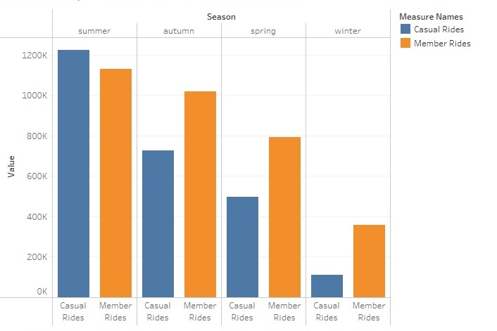
Seasons Effect on Total Rides for the Past 4 Seasons Total rides per season for annual members & casual riders
The number of rides varies widely by season.
Both annual members & casual rides reach their highest levels in summer and their lowest levels in winter.
What is the cause of this trend? (Is it the weather, summer vacation, or a combination of both?)
Number
of
Rides

Slide 8
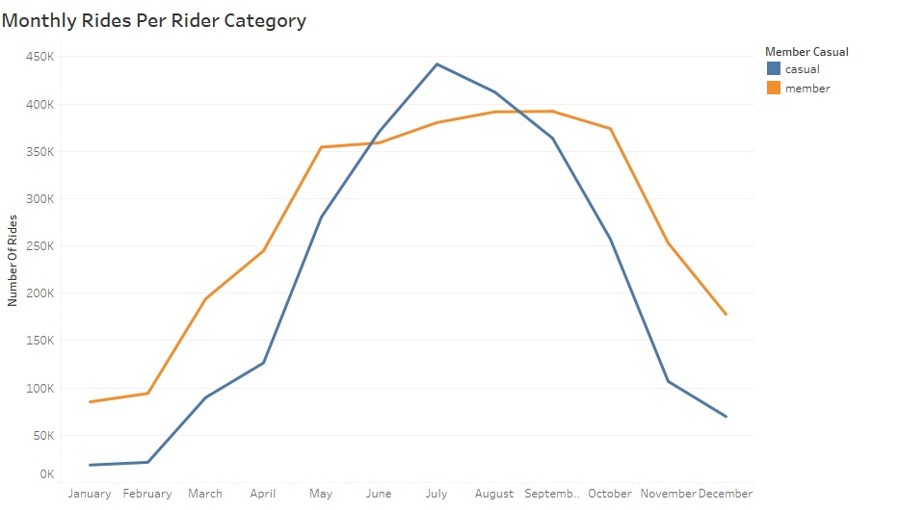
Total Rides Per Month for the Past 12 Months Rides separated to member rides & casual rides
There is no sudden peak and sudden drop in months, it is a gradual up and down the slope
The trend for the past 12 months confirms that the peak in total rides occurs in the summer months for both annual member and casual riders

Slide 9
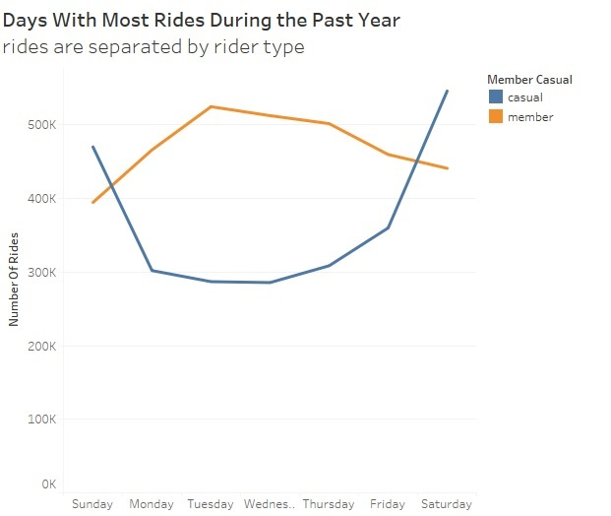
Days With Most Rides During The Past 12 Months Rides are separated by rider type
The behavior of both rider categories is totally the opposite during weekdays:
Casual riders use Cyclistic bikes the most during weekend days and the least during weekdays.
Annual members use Cyclistic bikes the least during weekend days and the most during normal weekdays

Slide 10
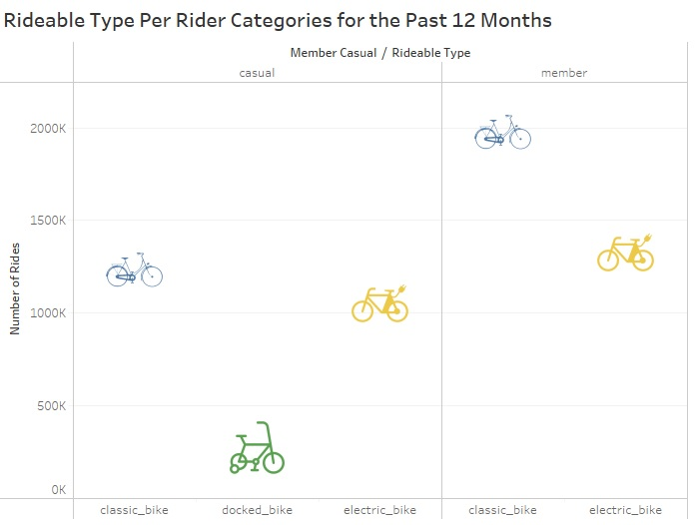
Rideable Type Per Rider Categories for The Past 12 Months
While annual members and casual riders use the classic bike more than other bikes but notice the following:
Annual members prefer classic bikes over electric bikes more than causal riders.
Casual riders use docked bike type while annual members are not using it at all.
20%
7%
Notes:
I confirmed that docked bike is a type of moving bike not a stopped bike by checking the start and end station for the rides using SQL query.
Percentages are calculated based on the total rides of each rider category.

Slide 11
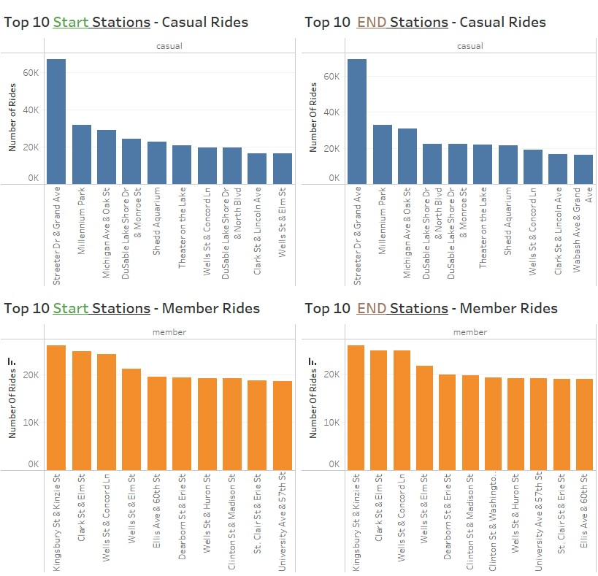
Top 10 Start & End Stations For annual members and casual riders
11%
11%
However, the top stations rides percentage is considered low but still member rides start and end in different stations than casual rides.
If our target is casual riders we should consider the frequently used station by them.
06%
06%
Notes:
- Percentage for each VIZ in the dashboard is calculated based on the total number of rides for each category

Slide 12
Cyclistic Riders' Usage Behavior Summary

Slide 13
The analysis will define the similarities and differences
Similarities:
Differences:
• Bikes are used the most to the least based on the below order of Seasons:
1- Summer
2- Autumn
3- Spring
4-Winter
• Classic Bikes are preferred over electric bikes
• Top 10 frequently used stations represent a low percentage of total rides made by each category
• Casual riders ride bikes the most during weekend days while annual members do the same during normal weekdays
• Casual riders use the docked bike types while annual members don’t
• The preference percentage of classic bikes over electric bikes for annual members is higher than casual riders’ preference percentage
•Frequently used start and end stations locations differ between the annual members and casual riders
Our Marketing Strategy Must consider the usage time and bike preferences to convert casual riders into annual members

Slide 14
Thank You

